Slide 1

Human Emotions influences Heart Rate using Amazon Rekognition API and Fitbit API
By: Fatema Hasta
Shreyaa Sridhar

Slide 2
Background and Motivation
Emotions play a large role in heart rate response. Anger, fear, and anxiety cause a rapid heart rate, while depression usually results in lowering of heart rate. Feelings of love, compassion, happiness usually result in slow heart action. Emotional stress causes heart rate to stay elevated.
We would like to detect and study the emotions and heart rate based on those emotions we experience say per day, consolidating it for a month, by visualizing the rate at which it changes. We can find critical insights from our visualizations, hence taking corrective measures towards emotions we want to improve upon.

Slide 3
Objective
The core idea of our project is to detect a person’s emotion using their facial expression and heart rate using their wearable fitness device, to gain useful insights on how their emotion and heart rate varies when they experience a certain emotion.

Slide 4
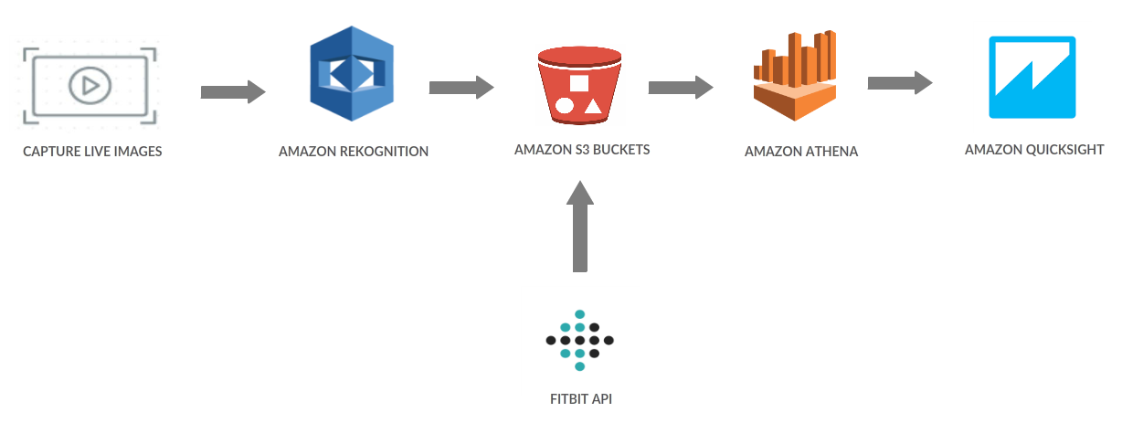
Architecture

Slide 5
Our Solution
Collection of dataset: Collected our real time facial images from October 14th 2018 to November 13th 2018, from 6pm to 10pm with 5 min burst time and our heart rate values using the Fitbit API for the same period..
Image Recognition: Amazon Rekognition API to detect the emotions of the images into HAPPY, CALM, DISGUSTED, SURPRISED, ANGRY, SAD and CONFUSED
Storage of data: Stored all the data into Amazon S3 buckets.
Data Querying: Used Join commands to combine the emotion results and heart rate with respect to time. Also found Average heart rate expressed for each emotion.
Visualization: Passed the results to Quicksight to visualize heart rate , emotion results and average heart rate expressed by each emotion.

Slide 6
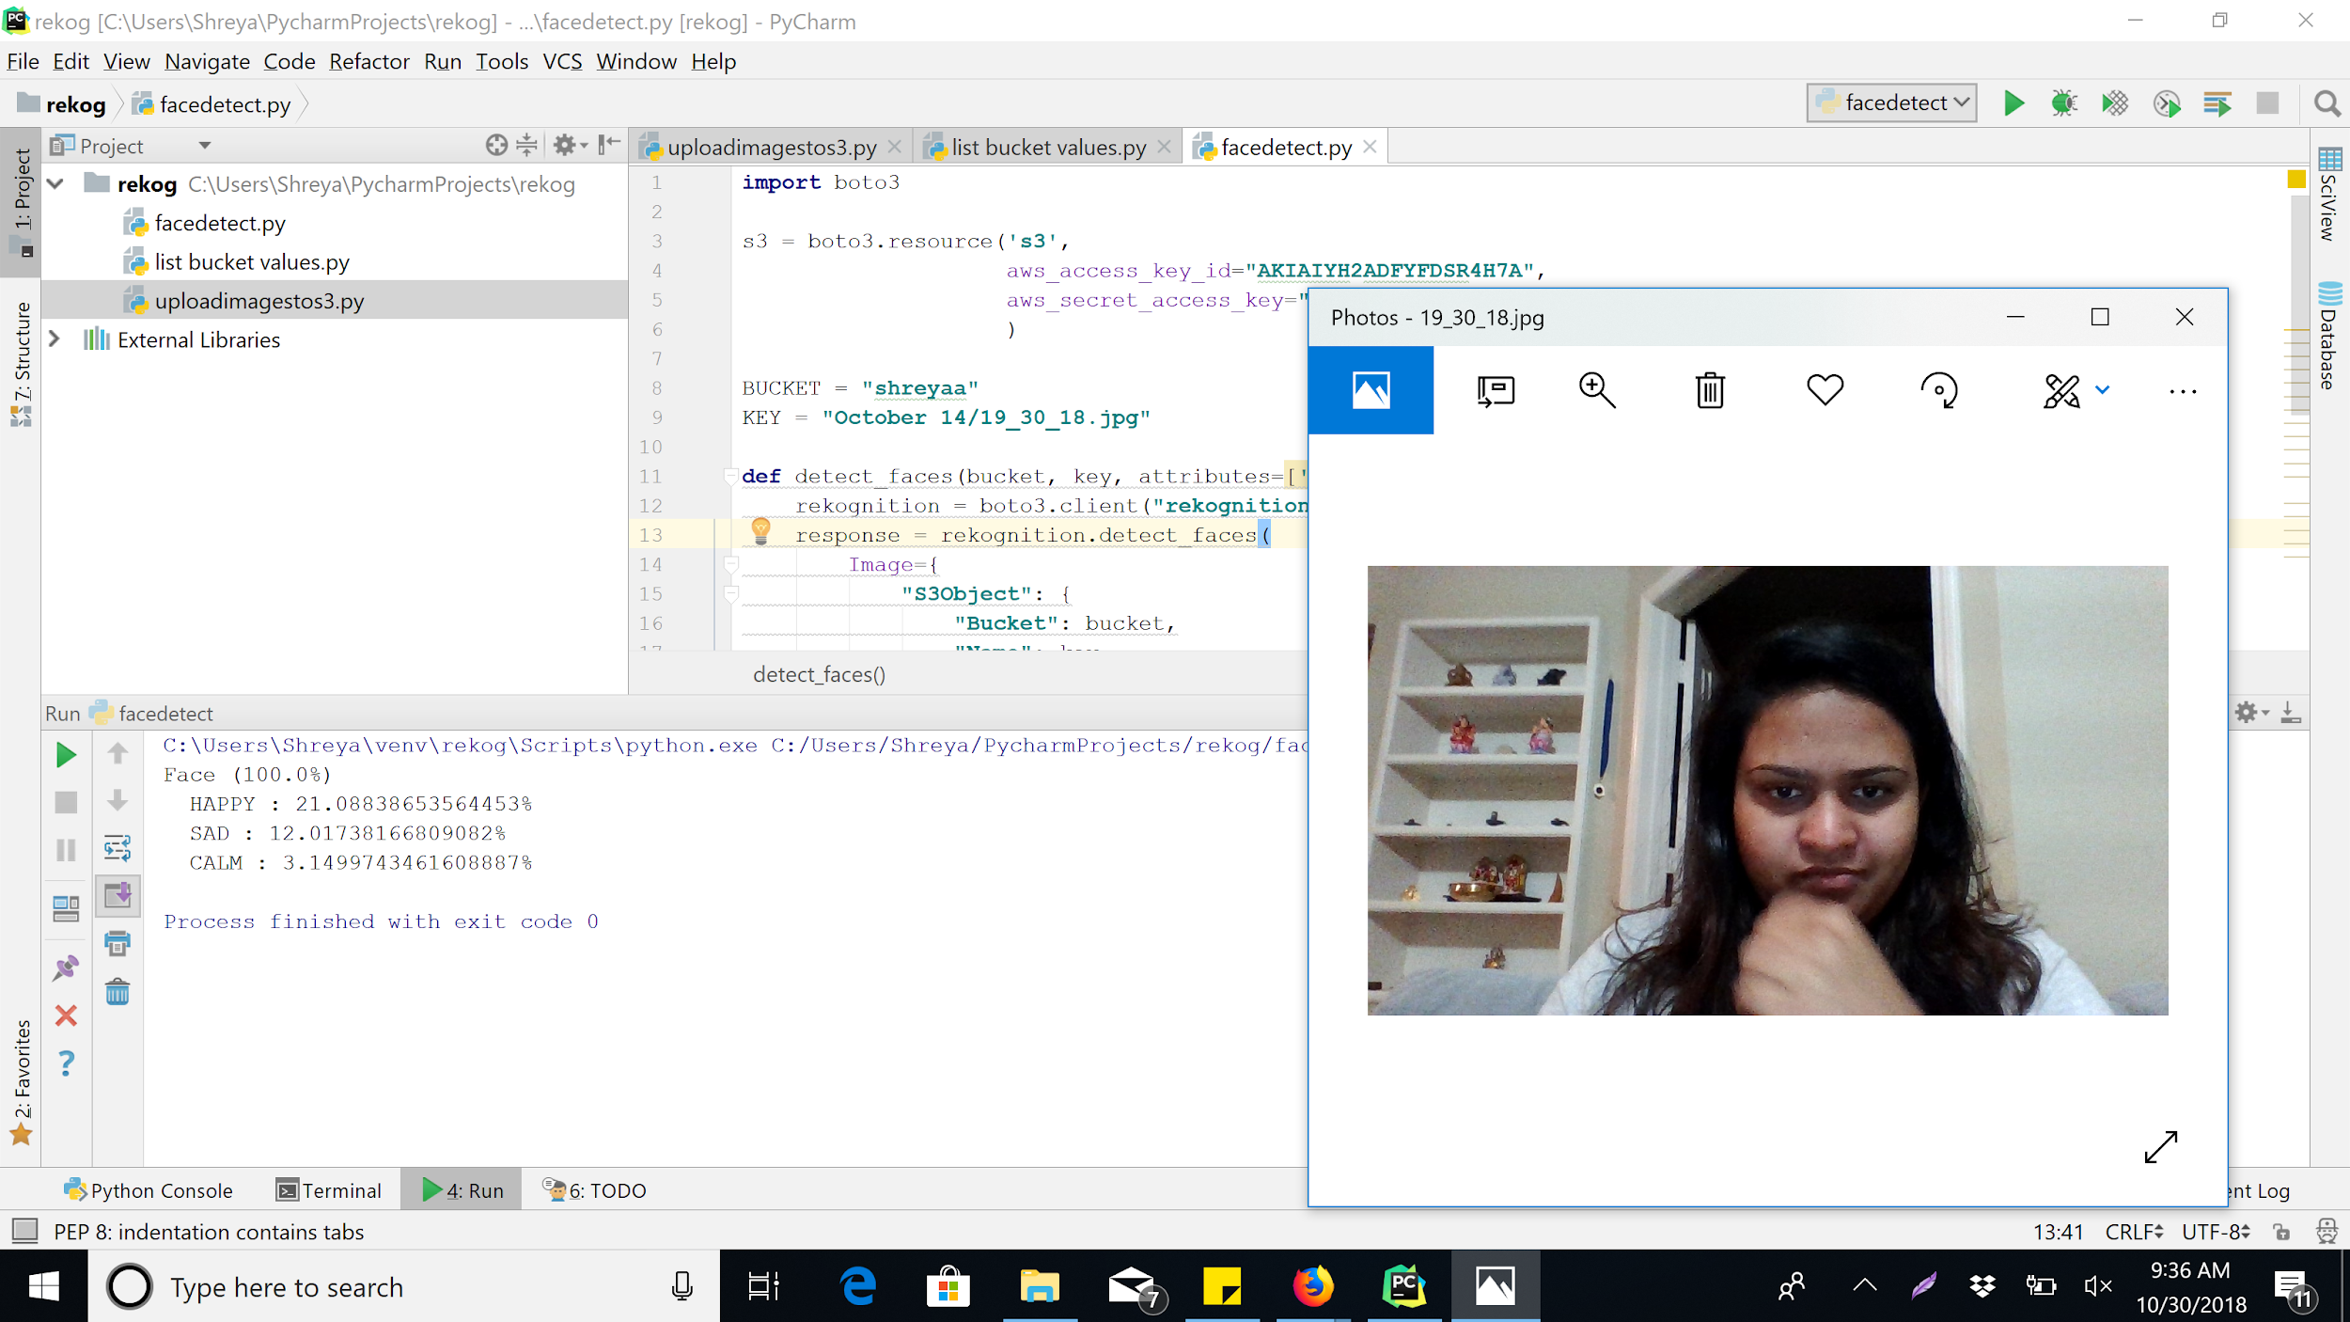
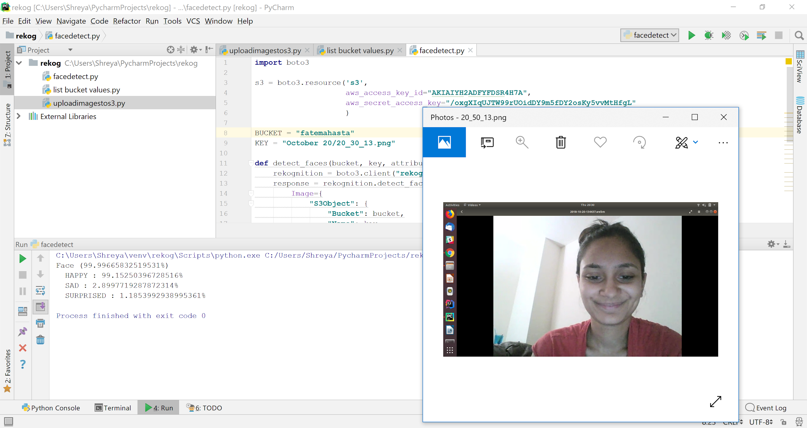
Amazon Rekognition

Slide 7
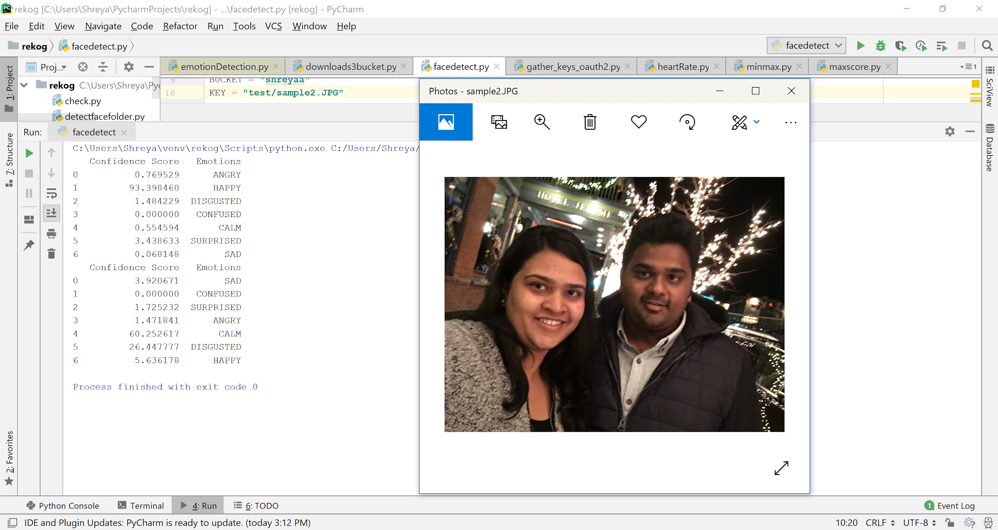
Amazon Rekognition(contd.)

Slide 8
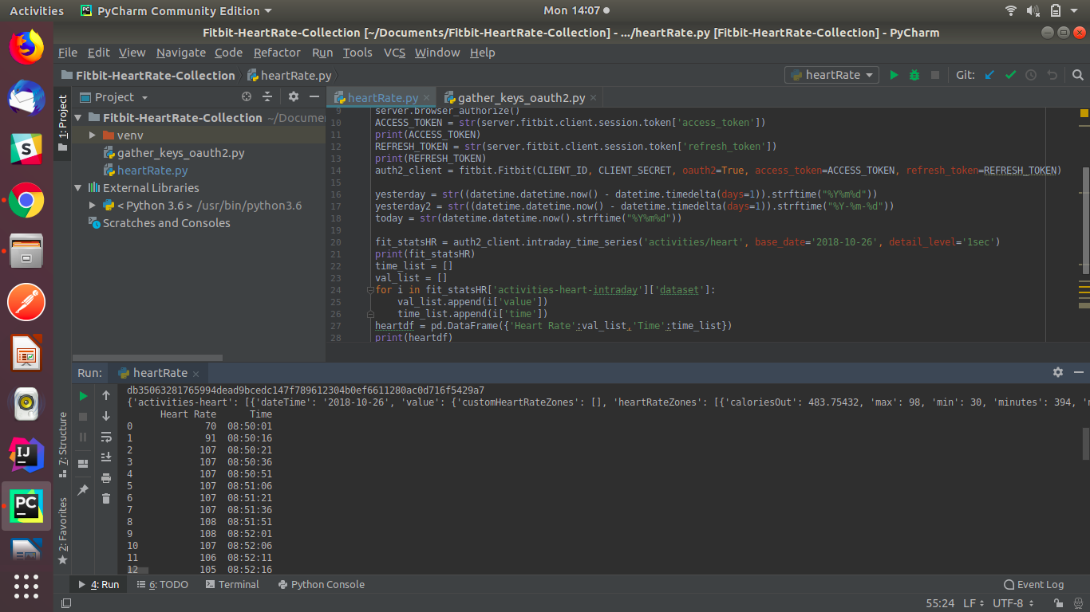
Fitbit API

Slide 9
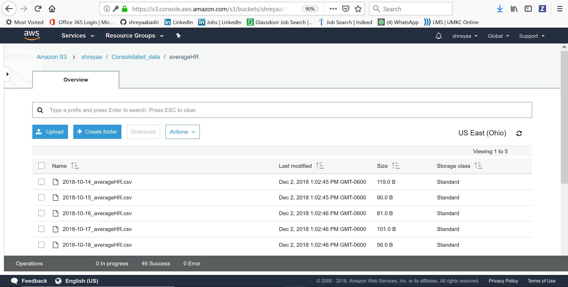
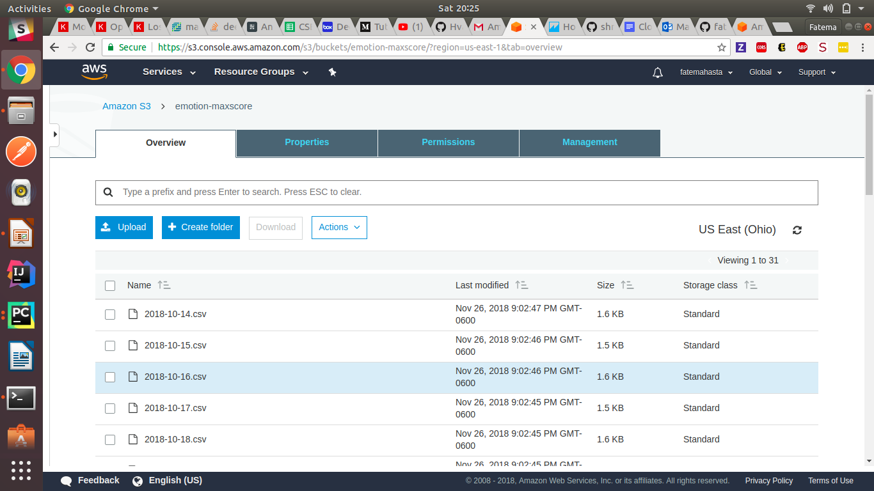
Amazon Storage S3

Slide 10
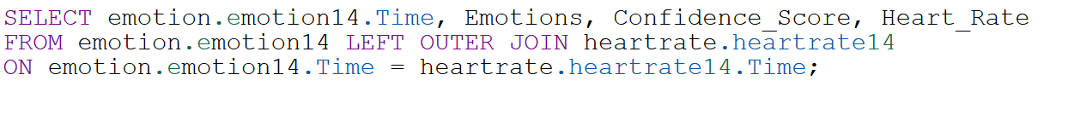
Amazon Athena (Data Querying)
SQL Queries to perform JOIN operations
Combines multiple files at a time.

Slide 11
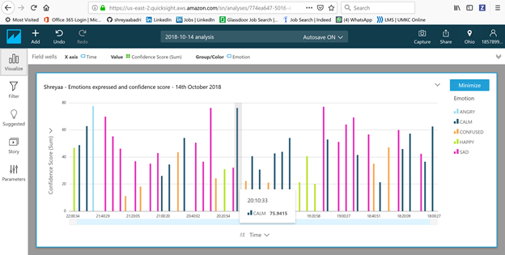
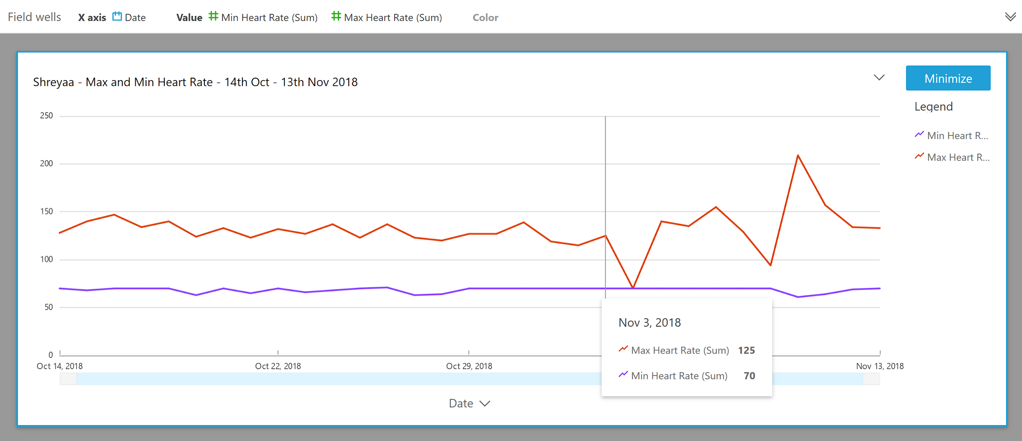
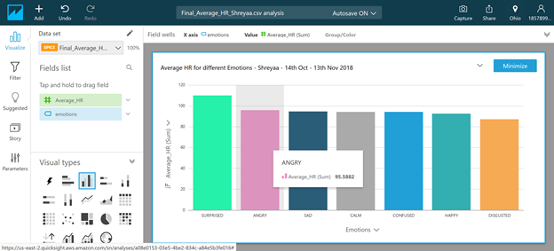
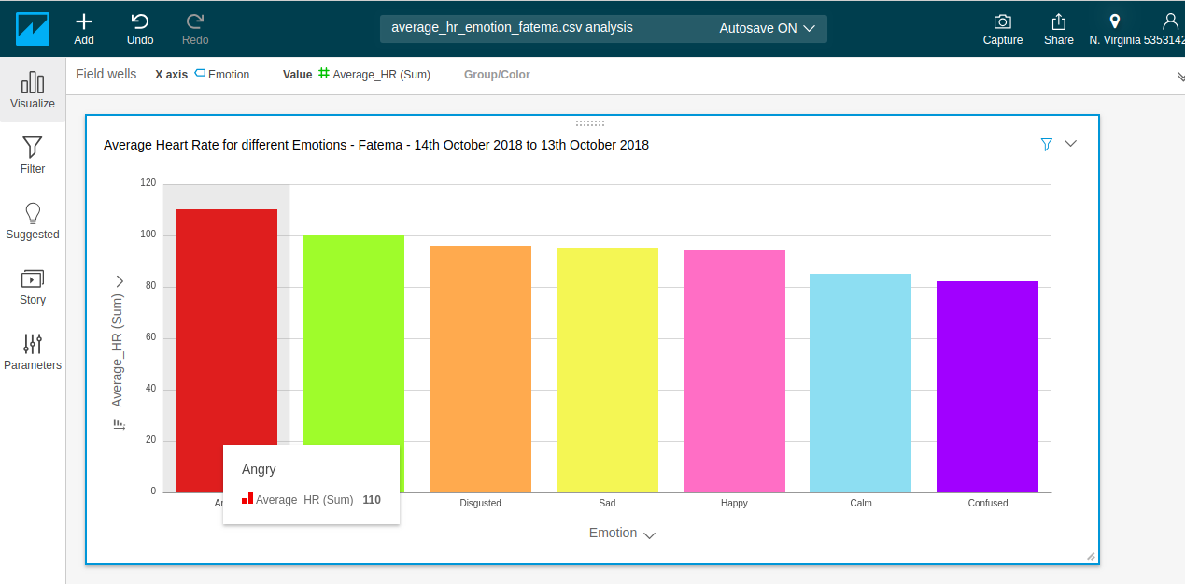
Amazon QuickSight (Visualization)

Slide 12
Inferences
After analyzing the graph between emotion and average heart rate, we can conclude that emotions totally play a role in fluctuating heart rates.
Fatema’s Emotion-Heart-Rate Analysis:
Fatema’s heart rate is the maximum (110) when she is very angry, whereas her heart rate is low at a value of 82 when she is confused.
Also there is are not much fluctuations in heart rate when she is Happy/Sad/Disgusted. They are quite aligned to heart rate value of 87.
Shreya’s Emotion-Heart-Rate Analysis:
Shreya’s heart rate is the maximum (110) when she is surprised, whereas her heart rate is low at a value of 84 when she is disgusted.
Also there is not much fluctuations in heart rate when she is Sad/Calm/Confused. They are quite aligned to heart rate value of 88.

Slide 13
Advantages and Disadvantages
The visualization graphs between heart rate and emotion really tell you how the emotions influence heart rates.
Our visualization can help a person understand his/her emotions in-depth and take corrective measure in order to manipulate a certain emotion, depending on whether that emotion dominates his/her life
Image data set consists of images taken when we spent time working on our laptop. .

Slide 14
Challenges
The initial challenge that we faced was the collection of dataset which really was time consuming and took lots of effort.

Slide 15
Learning Outcome
We really are fascinated to look at how a particular emotion really dominates us and how our heart rate fluctuates when we experience a particular emotion.
Learn to use Amazon Rekognition API for facial analysis.
Learn to use Amazon s3 and Amazon Athena.
Learn to gain insights on our data and visualize using Amazon Quicksight.

Slide 16
Future Work
In the future, we plan to extend our project by creating a web application, which will except a real time face image as an input, and will detect the emotion of the person in the image using the Amazon Rekognition API. We will also detect the heart rate from the wearable device and display it on our webpage. It will then create a visualization in the form of a graph for that particular emotion and heart rate.

Slide 17
Team Collaboration
We both put in joint efforts into:
Collection and Creation of facial image dataset and fitbit heart rate data
Storage of dataset in AWS S3 buckets
Using Amazon Athena to query data and generate useful insights
Using Amazon QuickSight to visualize data.

Slide 18
References
https://console.aws.amazon.com/rekognition/home?region=us-east-1#/face-detection
https://docs.aws.amazon.com/AmazonS3/latest/dev/Welcome.html
https://docs.aws.amazon.com/quicksight/index.html#lang/en_us
https://dev.fitbit.com/build/reference/web-api/heart-rate/
https://docs.aws.amazon.com/athena/latest/ug/understanding-tables-databases-and-the-data-catalog.html

Slide 19
Checkout of Video and Project here!
Github Link: https://github.com/shreyaabadri/Cloud-Computing-Project-Fall-2018
Video Link: https://youtu.be/DstXGGYwnkc

Slide 20


